Slide 1

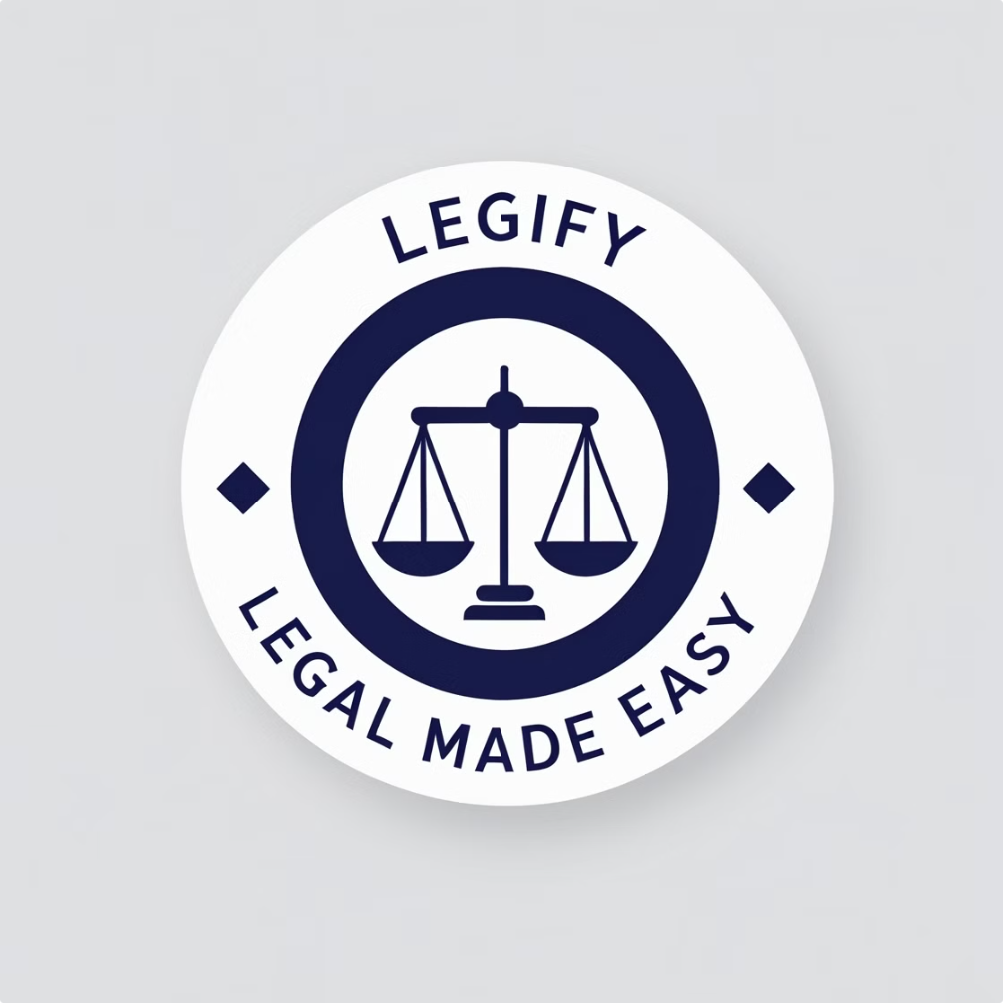
LEGIFY: Empowering Legal Teams with AI Precision
Simplifying legal workflows and unlocking efficiency for businesses in Tunisia.
Notes:
*“Hi, we’re Legify, and we’re here to make legal workflows simpler, faster, and more reliable for businesses in Tunisia.
Our mission is to transform how companies handle legal tasks like contract drafting, compliance checks, and risk analysis—using the power of AI.
Now, you might think that legal processes are something that’s already been solved, right?
But if you’re working at a growing company, especially in Tunisia, you know that’s not quite true.

Slide 2

The Challenge in Legal Workflows
Time-Consuming Processes
High Legal Costs
Compliance Complexities
Manual legal processes are excessively time-consuming and prone to errors.
Businesses face high costs from external legal counsel for routine tasks.
Navigating compliance with local and international regulations is challenging.
Notes:
So, what’s the real problem?
*“Imagine being in this situation: you need to draft or review a contract, and it takes hours to get it right. You worry about compliance with local regulations, but you don’t have neither the time nor resources to dig into every update. You have to rely on external legal experts—adding extra costs to your bottom line.
And here's the kicker: it’s not just about saving time—it’s about avoiding mistakes that can cost you much more down the road. Every error, every missed risk, every overlooked compliance requirement could end up being a huge liability.
In short, businesses are stuck in an outdated, slow, and expensive legal process. But what if we could change that?”*

Slide 3

How LEGIFY Solves These Challenges
Before
After (with LEGIFY)
Manual research & drafting
Automates contract drafting, review, and compliance checks.
Time-consuming compliance checks
High risk of errors & delays
Provides instant legal insights and guidance for employees.
Reduces reliance on large legal teams or external counsel.
Notes:
*“Introducing Legify. We’ve created a platform that makes legal workflows faster, smarter, and more accurate—without the need for costly external counsel or endless hours spent reviewing documents.
With Legify, you can:
Draft compliant document in minutes.
Analyze risks instantly.
Access real-time legal insights.
We’ve designed this platform to be the ultimate legal assistant, one that takes care of the heavy lifting so you can focus on growing your business.”*

Slide 4




AI-Powered Features of LEGIFY
Contract Drafting Assistant
Contract Review and Risk Analysis
LEGIFY's AI-powered contract drafting assistant streamlines the process of creating legally sound contracts. It suggests relevant clauses, flags potential issues, and accelerates the overall process.
Our AI analyzes contracts for potential risks and compliance issues, providing you with comprehensive insights and recommendations to ensure your contracts are legally sound and protect your interests.
Automated Legal Research Assistant
Employee Guidance Bot
Empower your employees with instant legal guidance. Our chatbot provides quick answers to common legal questions and directs them to relevant resources.
Access instant legal insights using our AI-powered research tool. Quickly find relevant laws, regulations, and precedents, saving valuable time and resources.
Notes:
The Contract Drafting Assistant allows you to create fully-compliant, customized contracts with just a few inputs—saving hours of work.
The Contract Review and Risk Analysis feature automatically flags potential risks in any document, from ambiguous clauses to missing terms, giving you actionable suggestions.
Automated Legal Research Assistant: Instantly access laws, regulations, and precedents for quick decision-making.
Employee Guidance Bot: Providing employees with instant answers to common legal questions or procedures at work.
“The legal tech market in Tunisia is underserved,

Slide 5

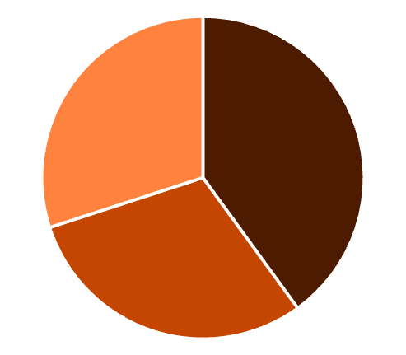
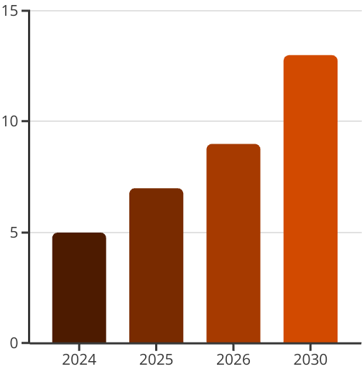
Market Opportunity
Total Market Size: 600–921 Million TND
Potential Takeover: 30.7–92.1 million TND (5–10% Share)
Large Law Firms
SMBs
Corporate Legal Teams
Target Audience
Tookover Projections
Notes:
with a potential market size of 600–921 million TND.
Legify is positioned to capture 5–10% of this market by addressing the needs of SMBs, large law firms, and corporate legal teams.

Slide 6

Scalable and Profitable Business Model
Subscription-based pricing
Customization packages
Tailored to company size
For enterprise clients
Revenue streams
SaaS subscriptions, consulting, and data analytics
Notes:
*“Our business model is designed to be as scalable as the technology we’ve built.
We offer subscription-based pricing that’s tailored to the size of the business, ensuring it’s accessible to both SMBs and large enterprises…etc
Customization packages are available for businesses with more complex needs.
Our revenue streams come from SaaS subscriptions, additional service offerings, and data analytics, ensuring we can grow sustainably while providing value at every level.”*
*"In Tunisia, Legify is uniquely positioned as probably the only dedicated player in the legal tech space. Giving us a significant opportunity to dominate the market by providing tailored solutions for local businesses.

Slide 7
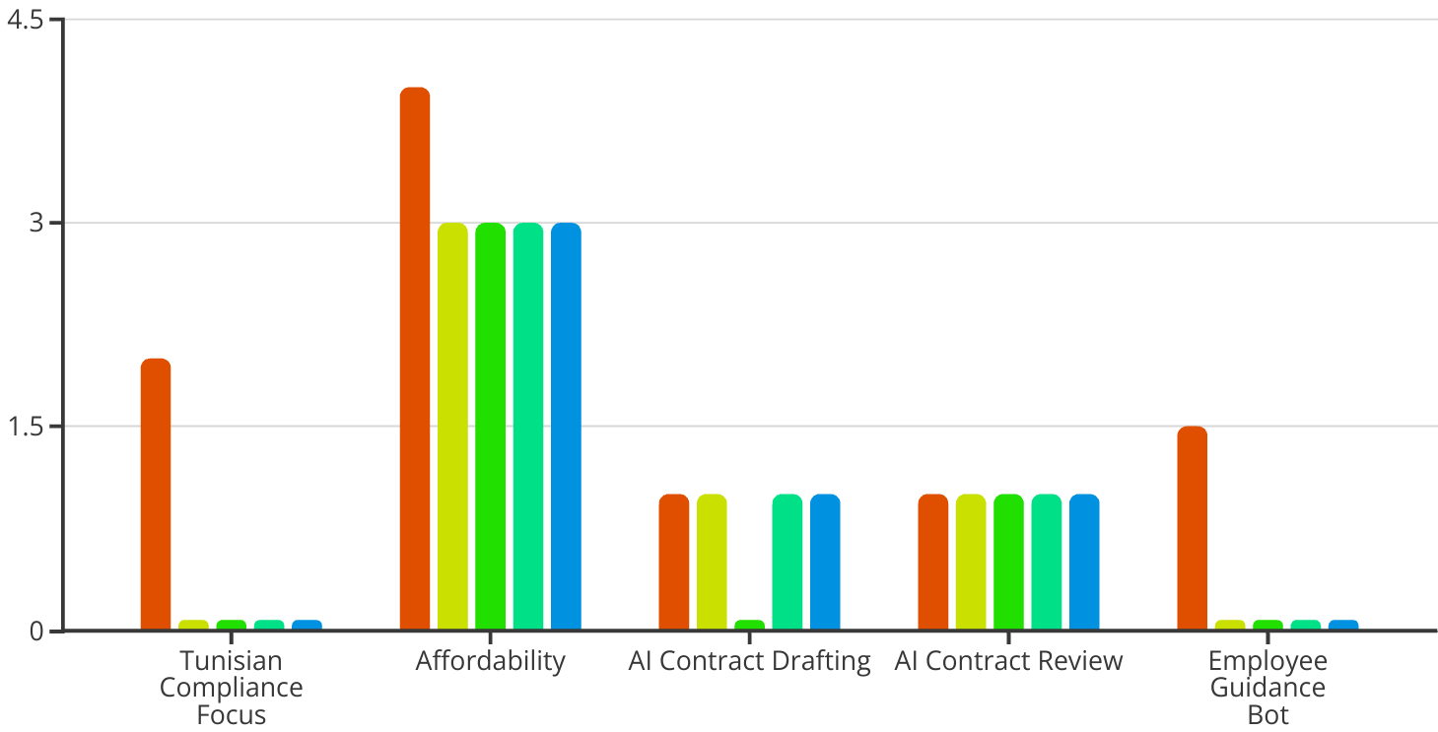
Standing Out in a Competitive Landscape
LEGIFY
Spellbook
eBrevia
Onit ReviewAI
NexLaw
Notes:
International platforms, on the other hand, like Spellbook, eBrevia, and Onit ReviewAI offer generic solutions, they lack the local expertise required to address the unique challenges of Tunisian businesses.
This local focus, paired with our comprehensive approach, positions us as the ultimate legal tech solution for Tunisia, while remaining competitive on a global scale."*

Slide 8



Impact on Communities
Improves Access to Legal Services
Supports Small Businesses and NGOs
Promotes Equity and Inclusion
Notes:
"Legify isn’t just for businesses—it improves access to legal services for small businesses, NGOs, and individuals. By streamlining processes and reducing costs, we’re creating a more inclusive legal environment that even individual citizens can access high-quality legal support with ease.
*“Legify isn’t just transforming legal workflows—it’s opening the door to endless possibilities.
Imagine a world where legal operations are no longer a bottleneck but a competitive advantage. That future starts today, and we’re inviting you to be part of it.
Thank you.”*

Slide 9





Meet the Experts Behind the Solution
Aymen Mathlouthi
Lindaa Rajab
Designer
Marketing Manager
AI engineers :
Oubeid Jemli
Sarra Hammami
Ghassen Rhouma

